Slide 1
Notes:
This slide should open and close your presentation. DO NOT put anything on this slide other than the origin logo.

Slide 2
This is a Trek title slide with logo

Slide 3
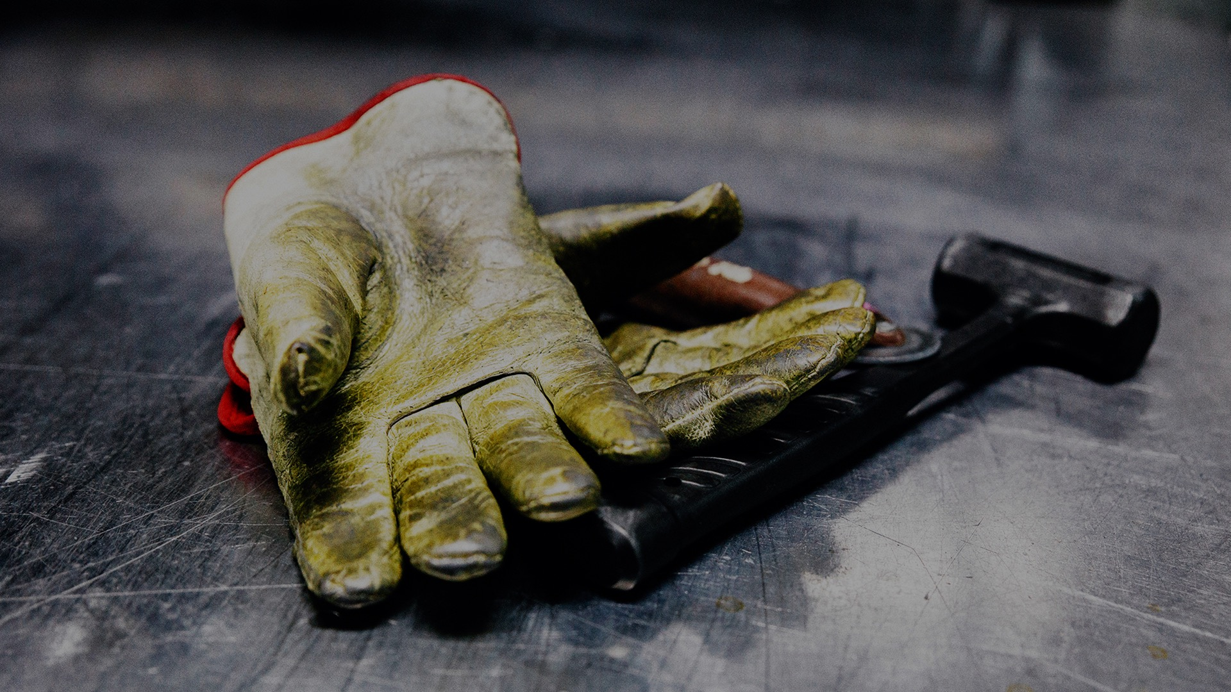

This is a Trek title slide with logo
Notes:
This uses the Picture, full frame layout, with logo, line, and text box dropped on top of the image

Slide 4
Title or section header with no logo
00 Month 2018

Slide 5

Title or section header with no logo
00 Month Year
Notes:
This uses the Picture, full frame layout, with text boxes and divider line dropped on top of the image in the same position as the Title + subtitle, no logo layout

Slide 6

This is a Trek title slide with logo
Notes:
This uses the Title + picture, bottom layout, with logo and divider line dropped on top of the image

Slide 7
This is a body slide with a title
Body slides have no logos
  There are also body layouts with no title
  And body layouts that have vertically centered text
There are white body slides, too
  For use only when necessary
  (for example, for a photo with a white background)

Slide 8
Not every slide needs a title. A key point set apart on its own slide can have a big impact.

